Slide 1


5 Domains of Writing

Slide 2
Style
Style is the choice, use and arrangement of words and sentence structures that create tone and voice

Slide 3
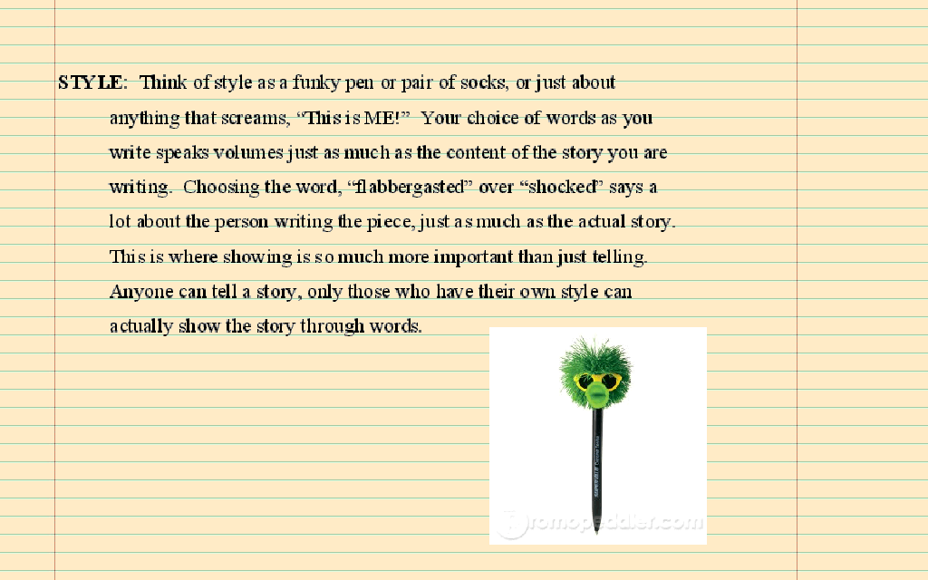

Slide 4
How do you write with strong style?
To write with strong style a writer must use precise, illustrative use of a variety of words and sentence structures to create consistent writer's voice and tone

Slide 5
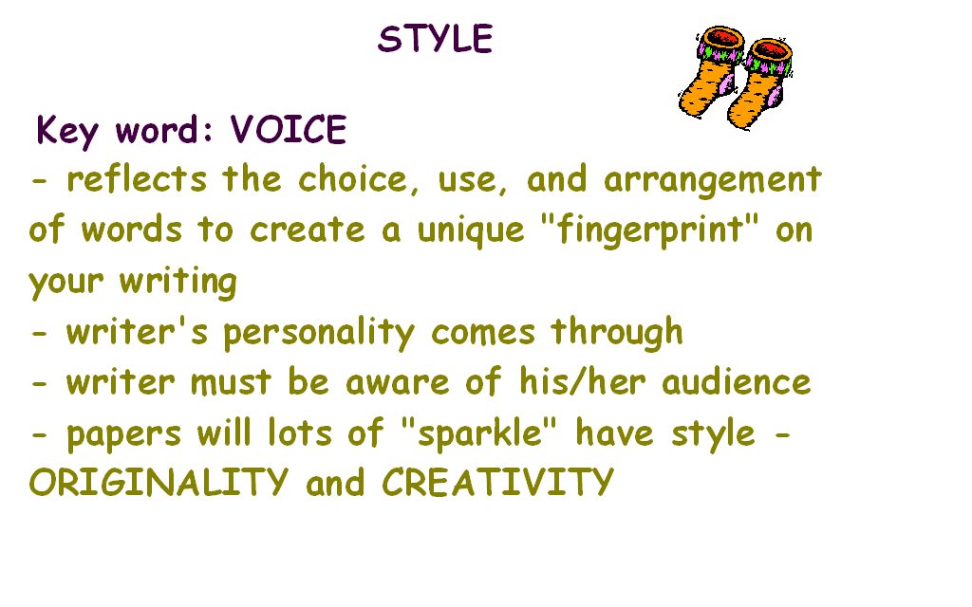

Slide 6
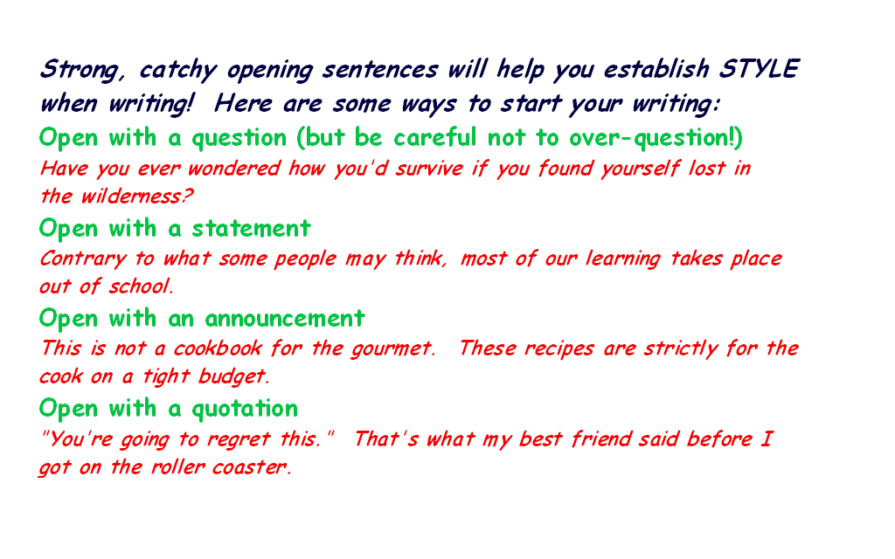

Slide 7
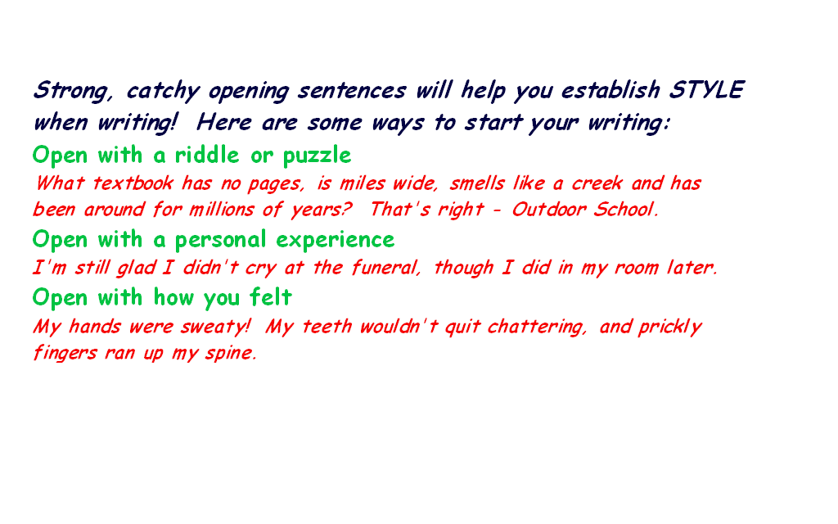

Slide 8
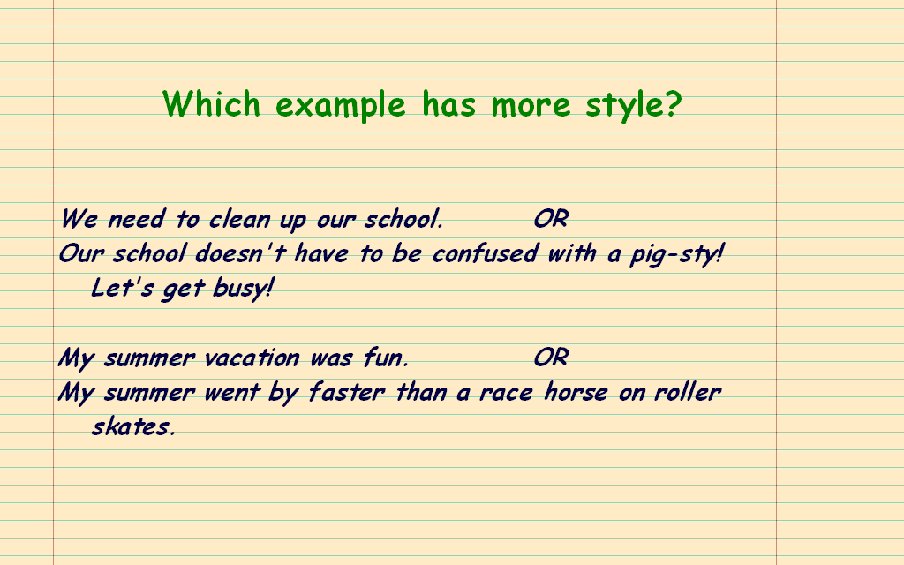

Slide 9
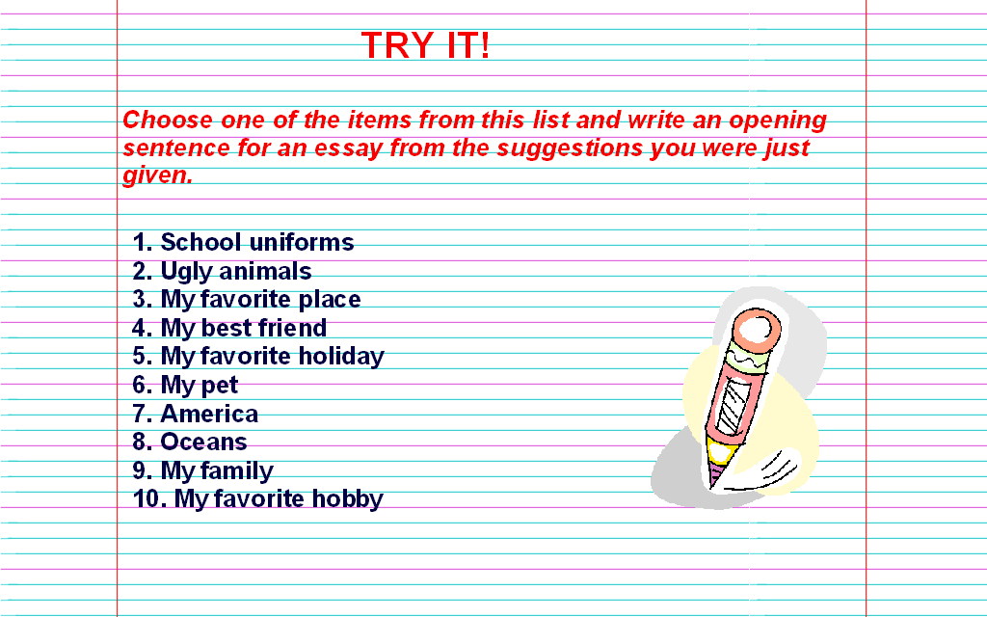

Slide 10
